Slide 1
HDMI-enabled Designs Using the ADV7513
Analog Devices, Video Transmitters Product Line
December 2011

Slide 2
Presentation Overview
Introduction to the ADV7513
Block Diagram and Features
Support Documents
Basic Setup and Configuration
Example schematic and Quick-Start Setup Guide
Processor Interface and general control
I2C, Interrupts, Hot-plug Detect, DDC, EDID,
Video Input
Audio Input
HDMI Output
Power Domains
Advanced Usage
Video Formatting
CSC, 422<->444 conversion, DE and Sync Generation
Pixel Repetition
CEC
HDCP

Slide 3
Introduction to the ADV7513

Slide 4
ADV7513 Features Overview
Supports display resolutions at 25~165 MHz (up to 1080p/UXGA)
Incorporates extended HDMI v1.3/1.4 features
Supports extended colorimetry (e.g. x.v.ColorTM)
HBR audio formats
DST/DSD audio formats
3D Ready (720p50/60 & 1080p24/25/30)
Integrated CEC support
Buffer CEC signals
Off-loads real-time monitoring from host µP
Low standby power
Software driver → Easy implementation
On-chip HDCP support
Automated or programmable color space converter
Flexible video inputs:
RGB 4:4:4, YCbCr 4:4:4, YCbCr 4:2:2
24-bit input interface
Supports ITU656 style embedded syncs
Integrated I2C Master for DDC bus
+5V tolerant I/Os for HPD and I2C
1.8V & 3.3V supplies
CECCLK
CEC
Interpreter
CEC
S/PDIF
Audio
Data
Capture
MCLK
4:2:2
↕
4:4:4
&
Color
Space
Converter
HDCP
Keys*
I²S[3:0]
LRCLK
SCLK
HDCP
Encryption
D[23:0]
Video
Data
Capture
HS
TMDS
Outputs
VS
Tx0
DE
Registers
&
Config.
Logic
Tx1
CLK
Tx2
HPD
TxC
INT
I²C
Slave
SDA
I²C
Master
SCL
HDCP &
EDID
Micro-
controller
DDCSDA
DDCSCL
Part | Description
ADV7513BSWZ | Standard
EVAL-ADV7513-AKZ | Evaluation Kit

Slide 5
ADV7513 Reference Documents
ADI Documents
Data Sheet
Feature list
Electrical specifications
Pin diagrams and descriptions
Package drawings
Hardware User's Guide
Detailed descriptions of hardware blocks
External connection recommendations
PCB layout guidelines
Programming Guide
Detailed register maps and descriptions
Programming guidelines organized by system level function
Software Driver User's Guide (DVP Transmitter Library Specification 1.9)
Detailed description of C code functions that can be integrated into system SW
Describes how functions are used to meet HDMI requirements
User Guides, schematics, etc. available on ez.analog.com

Slide 6
ADV7513 Reference Documents
Other Documents
HDMI Specification 1.4
Beyond the obvious, detailed information on CEC and HDMI compliance are included
EIA/CEA-861
Includes timing specifications for various video formats
HDCP 1.3
IEC 60958
Audio standard
IEC 61937
Advanced audio standard
I2C-Bus Specification

Slide 7
Basic Setup and Configuration

Slide 8
Example Schematic
Power Domains
Go Back

Slide 9
Programming Quick-Start Guide
Power-up the Tx (HPD must be high)
0x41[6] - Power-down (Power-up = 0)
Fixed registers that must be set on power up
0x98 = 0x03
0x9A[7:5] = 0b111
0x9C = 0x30
0x9D[1:0] = 0b01
0xA2 = 0xA4
0xA3 = 0xA4
0xE0 = 0xD0
0xF9 = 0x00
Set up the video input mode
0x15[3:0] – Video Format ID (default = 4:4:4)
0x16[5:4] – Input Color Depth for 4:2:2 (default = 12 bit)
0x16[3:2] – Video Input Style (default style = 1)
0x17[1] – Aspect ratio of video in (4x3 = 0, 16x9 = 1)

Slide 10
Programming Quick-Start Guide
Set up the video output mode
0x16[7] - Output Format (4:4:4 = 0)
0x18[7] - CSC Enable (YCbCr to RGB = 1)
0x18[6:5] - CSC Mode (YCbCr to RGB = 0b00)
0xAF[1] - Manual HDMI or DVI mode select (HDMI = 1)
Audio setup
0x01 – 0x03 = N Value (0x001800 for 48kHz)
0x0A[6:4] – Audio Select (I2S = 0b000, SPDIF = 0b001, HBR = 0b011)
0x0B[7] - 0b1 – SPDIF Enable (Enable = 1)
0x0C[5:2] - I2S Enable (Enable = 0b1111)
0x15[7:4] – I2S Sampling Frequency (48kHz = 0b0010)
0x0A[3:2] = Audio Mode
HDCP
0xAF[7] = 1 for enable HDCP
0x97[6] – BKSV Interrupt Flag ( Wait for value to be 1 then write 1)

Slide 11
Processor Interface and General Control
I2C slave Interface
Standard I2C protocol up to 400KHz
Hardware considerations
SDA and SCL pins should be connected to an I2C Master
2KΩ (+/-5%) pull-up resistors to 1.8V or 3.3V recommended for each signal
Software considerations
Contains four memory maps
“Main” register device address is 0x72 (where the R/W~ bit is the LSB)
Contains all non-CEC status and control registers
“Packet Memory” device address is set by register 0x45 of the Main map.
Default setting is 0x70
“EDID Memory” device address is set by 0x43 of the Main map
Default setting is 0x7E
Used to store EDID that is automatically retrieved from HDMI sink device
“CEC Memory” device address is set by 0xE1 of the Main map
Default setting is 0x78
Used for CEC related control and command storage
See schematic

Slide 12
Processor Interface and General Control
Interrupts
INT pin enables interrupt driven system design
Connect to the input of the system controller
Should be pulled up to the power rail that supplies power to the system controller (either 1.8V or 3.3V) through a resistor (2KΩ to 5KΩ)
List of Interrupts (green text indicates most commonly used basic interrupts)
Interrupt-related registers (Main map)
Interrupts and their enable bits are found in registers 0x92 – 0x97
“Status” bits are also available for system level monitoring (HPD and Rx_sense for ex.)
See schematic
Hot Plug Detect (HPD)
Edge sensitive
Rx Sense
Edge sensitive
EDID Ready
EDID successfully uploaded and ready to parse
Active Vsync Edge
Can be used when dynamically changing video-related parameters such as color space
Audio FIFO Full
Embedded Sync Parity Error
HDCP Authenticated
HDCP Error
BKSV Flag
Wake Up Op Codes
CEC Tx Ready Flag
CEC Tx Arbitration Lost Flag
CEC Tx Retry Timeout Flag
CEC Rx Ready Flags

Slide 13
Processor Interface and General Control
Interrupts (continued)
Interrupt handling
The figure below shows the process of detecting and clearing an interrupt
The interrupt pin and interrupt register become active simultaneously when an event triggers an interrupt
System software processes the interrupt, and then writes a ‘1’ to the interrupt register to clear the register and set the interrupt pin back to inactive
The pin will remain active until each active interrupt register is cleared
Interrupt handling example in Programming Guide
Wait for Interrupt
(INT pin inactive,
Int. registers = 0)
Write ‘1’ to interrupt register
Event causes
an interrupt
Process Interrupt
(INT pin active,
Int. register = 1)

Slide 14
Processor Interface and General Control
Hot-plug Detect (HPD)
Detects if a DVI or HDMI sink is connected
Voltage on HPD > 1.2V = sink is connected
Hardware considerations
HPD connects directly to HDMI connector
10KΩ pull down resistor to ground recommended
ESD device may also be connected
Software considerations
Use HPD interrupt or status (R0x42[6]) to initiate ADV7513 configuration
Start with powering up the device via R0x41[6]
“Quick-Start Guide” section provided in the Programming Guide
When HPD is low, some registers will be reset to their default values and cannot be written to:
See schematic
Address (Main Map) | HPD Pin | Power Down (0x41[6]) | Full Reset (0xF8[7])
0x00 – 0x7C | Reset | Not Reset | Reset
0x92 – 0xAE | Not Reset | Not Reset | Reset
0xAF-0xCC | Reset | Reset | Reset
0xCE -0xFF | Not Reset | Not Reset | Reset

Slide 15
Processor Interface and General Control
Display Data Channel (DDC) Controller
I2C master connected to DDCSDA and DDCSCL pins of HDMI connector
1.5K – 2.0KΩ pull up resistor to the HDMI +5V supply required on each
ESD device may also be connected
Usage
EDID download and buffering from sink device
Done automatically when R0xC9[4] set from ‘0’ to ‘1’
EDID information is stored in EDID Memory Map
Information is used by system software to configure HDMI output appropriately for sink device
HDCP handling
Refer to Programming Guide
Current Reference
The ADV7513 uses an external resistor connected to the R_EXT pin to accurately set the internal reference currents
Connect 1.0KΩ (±1%) resistor from R_EXT to ground
Avoid routing high-speed AC or noisy signals next to the R_EXT trace or resistor
See schematic

Slide 16
Video Input
Supported Formats
Hardware Considerations
Video data input
Can use bus widths (number of pins) of 8, 10, 12, 16, or 24
Pin mapping and bus width set according to “Input ID” and “Input Style”
Use 50Ω trace impedance on PCB
Sync input
Accepts Hsync, Vsync, and DE signals on separate pins or as embedded data on the video data pins
Clock Input
Low-jitter, low-noise clock = best performance (max jitter is 2nS)
Use 50Ω trace impedance on PCB (minimize trace length)
Color Space | Bits per Color | Format | Sync Type | Clocks
YCbCr or RGB | 8, 10, or 12 | 4:2:2 or 4:4:4 | Separate or Embedded | 1x, 2x or DDR

Slide 17
Video Input
Software Considerations
“Input ID” register (0x15[3:1]) should be set to reflect the video data format, color space, bus width, # bits per color, and sync type that is input to the ADV7513 from the system SoC
“4:2:2 Width” register (0x16[5:4]) sets the bits-per-color when using an Input ID of 3, 4, or 6
“Input Style” register (0x16[3:2]) sets the pin mapping for video input data
01 = style 2, 10 = style 1, 11 = style 3
See Programming Guide or Hardware User’s Guide for pin mapping details
Input ID | Bits per Color | Bus Width | Format Name | Sync Type
0 | 8 | 24 | RGB 4:4:4 or YCbCr 4:4:4 | Separate syncs
1 | 8 | 16 | YCbCr 4:2:2 | Separate syncs
2 | 8 | 16 | YCbCr 4:2:2 | Embedded syncs
3 | 8, 10, 12 | 8,10,12 | YCbCr 4:2:2 2X clock | Separate syncs
4 | 8, 10, 12 | 8,10,12 | YCbCr 4:2:2 2X clock | Embedded syncs
5 | 8 | 12 | RGB 4:4:4, YCbCr 4:4:4 DDR | Separate syncs
6 | 8, 10, 12 | 8,10,12 | YCbCr 4:2:2 DDR | Separate syncs
7 | 8,10,12 | 8,10,12 | YCbCr 4:2:2 DDR | Separate syncs
8 | 8,10,12 | 8,10,12 | YCbCr 4:2:2 DDR | Embedded syncs

Slide 18
Video Input
Software Considerations (continued)
Input data clock
For formats with clock at 2 or 4 times the frequency of the data (480i at 27MHz, for example) “CLK Divide” (0x9D[3:2]) and “CLK Divide Enable” (0xA4[6]) need to be set accordingly
“Clock Delay” (0xBA[7:5]) setting can be used to better align the clock with data to ensure robust data capture

Slide 19
Video Input
Software Considerations (continued)
Synchronization
Separate Syncs using Hsync, Vsync, and DE pins
All 3 signals are transmitted as part of the HDMI interface
DE can be generated internally (registers 0x17[0], 0x35-0x3A) if Vsync and Hsync only are provided
Embedded Syncs
F, H, and V codes from the embedded syncs define the DE
H and V syncs must be generated using the Hsync and Vsync Generator
Automatically enabled when using Video ID’s 2 and 4
Registers 0x30 – 0x34 and 0x17[6:5]
Adjustments
The DE and sync generation circuits can also be used to adjust timing parameters to conform to the CEA861 specification as required by the HDMI specification
See Programming Guide for details

Slide 20
Audio Input
Supports I2S, and SPDIF audio from 32KHz up to 192KHz and HBR at 768KHz
I2S formats
Standard
left-justified
right-justified
direct AES3 stream
SPDIF formats
2-channel LPCM
IEC61937 encoded multi-channel audio
HBR
I2S Style
BPM Style
Hardware Considerations
I2S requires SCLK and LRCLK input (MCLK optional via Hsync pin)
SPDIF does not require a separate sampling clock (MCLK optional)
Match trace length of audio signals to optimize audio data capture
Add series termination resistors close to the audio source to minimize impedance mismatch

Slide 21
Audio Input
Software Considerations
Use R0x0A[6:4] to select I2S (‘000’), SPDIF (’001’), or HBR (‘011’)
“Audio Clock Polarity” (0x0B[6]) sets the audio sampling edge
SCLK edge for I2S, MCLK edge for SPDIF (no affect if not using MCLK)
I2S
R0x0C[1:0] selects I2S format (standard, right, left, AES3 direct)
Use “MCLK I2S” bit (R0x0A[2]) to enable MCLK using the Hsync input
Must also set the “MCLK Mux” bit (0xD6[6]) and the “HSYNC/MCLK Schmitt Enable” bit (0xE5[3])
SPDIF
“SPDIF Enable” (0x0B[7]) enables the SPDIF receiver
The “SPDIF Sampling Frequency” register (0x0A[7:4]) indicates the detected audio sampling frequency
HBR
“Audio Mode” (0x0A[3:2]) selects the number of streams and BPM or I2S style encoding

Slide 22
Audio Input
Audio Clock Regeneration
Audio sampling rate clocks are derived from video clock
N and CTS must be set appropriately for HDMI sink to recreate the audio clocks
N should be set according to tables 58-60 in Programming Guide
CTS is automatically generated based on detected audio and video rates when “CTS Source Select” (0x0A[7]) is set to auto mode

Slide 23
HDMI Output
“Output Format” register bit (0x16[7]) selects 4:2:2 or 4:4:4
Output color space is determined by the state of the Color Space Converter (CSC)
The Y1Y0 bits of the AVI Infoframe (0x55[6:5]) should be set to match the HDMI output format
More information on the CSC on slide 30
HDMI uses 4 TMDS pairs
3 data pairs at up to 1.65GB
Clock pair up to 165MHz
Each pair should be routed differentially with 100Ω impedance (50Ω each to ground)
Low capacitance (<0.6pF) ESD suppressors recommended
Placed as close as possible to the HDMI connector.
Differential TMDS lines should be routed through the pad of the ESD suppressor to minimize the disruption in the differential impedance

Slide 24
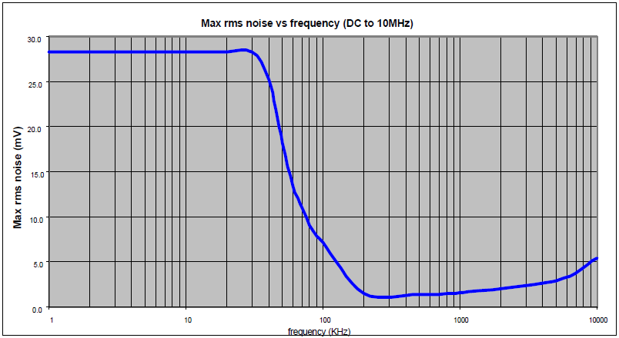
Power Supply Filtering
All 1.8V supply domains need to be as noise-free as possible
The graph below shows AVDD and PVDD Max Noise vs. Frequency

Slide 25
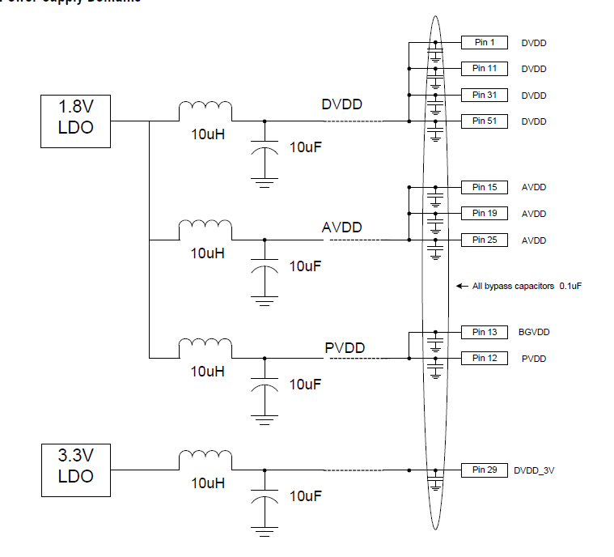
Power Domains
Three separate pcb power domains are recommended
Each with low-pass filtering that has a cutoff frequency between 10 and 20KHz
Each power pin should have a 0.1uF bypass capacitor placed as close as possible to the pin
Go Back

Slide 26
Consumer Electronics Control (CEC)

Slide 27
What is CEC?
CEC – Consumer Electronics Control.
A subsection of the HDMI specification
Not a required feature to be HDMI compliant.
Basic function is to connect all HDMI equipped devices into a network, and be able to control any device on the network from any other device, e.g. TV remote control could control HS, DVC, DSC
Some typical commands are “one touch play”, “stand-by”, “Record”
Allows additional commands, which are defined by a device maker.
Basic PHY spec
Serial bit transmission mechanism.
It is a very low speed bus (400Hz)
Uses full CMOS signal swings (0V – 3.3V)

Slide 28
How is it being implemented in Tx?
The CEC bus specification is partitioned in its implementation.
Electrical PHY, bit signaling, and transmission
High level MAC layer, command translation, logical address generation, transmission error handling
Controller implementation on Tx is an “enhanced PHY”
All basic electrical operations, bit timings, etc.
Handles transmission errors and schedules re-transmission of faulty frames
Host processor will implement remainder of MAC layer functions.
“Command to action” translation
Logical address generation
These are functions that would be implemented in Software

Slide 29
Block Diagram: ADI Solution
Combination of H/W and S/W.
H/W is responsible for physical layer.
Signal level and bit timing.
0.1 – 5ms order.
S/W is responsible for (low level) application layer.
Logical address, physical address
Respond to the received message automatically.
Data link between System S/W.
5 - 50ms order.
Software
Hardware
ROM
ADV75xx
CEC driver
HDMI Tx
CEC
I2C
CEC
block
Micro processor
HDMI Tx driver
HDMI
Interrupt
System S/W

Slide 30
Advanced Usage

Slide 31
Video Formatting
CSC (color space converter)
Used when color space is different between input and output
RGB input to YCbCr output
YCbCr input to RGB output
Fully programmable
CSC control registers at 0x18 - 0x2F
Settings for common color space conversions contained in Programming Guide
HDTV YCbCr (16to 235) to RGB (16to 235)
HDTV YCbCr (16to 235) to RGB (0 to 255)
SDTV YCbCr (16to 235) to RGB (16 to 235)
SDTV YCbCr (16to 235) to RGB (0 to 255) - (Default Value)
RGB (16 to 235) to HDTV YCbCr (16to 235)
RGB (0 to 255) to HDTV YCbCr (16to 235)
RGB (16 to 235) to SDTV YCbCr (16to 235)
RGB (0 to 255) to SDTV YCbCr (16to 235)
Identity Matrix (Output = Input)

Slide 32
Video Formatting
4:2:2 to 4:4:4 and 4:4:4 to 4:2:2 conversion
Used when input and output format doesn’t match
No need to enable/disable the function. If the format doesn’t match, it will be automatically enabled.
There are 2 options for 4:2:2 to 4:4:4 model
Zero-order (repetition)
First- order (linear interpolation)

Slide 33
Video Formatting
Pixel Repetition
Why is pixel repetition needed?
To increase the amount of blanking period available to send packets
To increase the pixel clock frequency to meet the minimum specified clock frequency (25MHz)
Three modes of operation using 0x3B[6:5]
Auto mode
Uses the audio sampling rate and detected VIC information to determine if pixel repeat is needed to obtain sufficient blanking periods to send the audio
Manual mode
VIC sent in the AVI info should also be set in register 0x3C
The multiplication factor of the input clock must be programmed in 0x3B[4:3]
Pixel repeat value sent to the Rx must be programmed in 0x3B[2:1].
Max mode
Same as auto mode, except it selects the highest pixel repeat multiple possible
Video timing is independent of the audio sampling rate
Not typically used.

Slide 34
TMDS Power Down
Used to ensure no corrupted video is sent during register setup
Procedure:
Power Down the TMDS Clock and Data right after setting 0x41[6] to 0 to power up the device
Power Up the TMDS lines when video input is stable and register settings are complete
Soft TMDS Clock Turn On is recommended if TMDS Power Down is used
Helps avoid Rx Sense glitches caused by active Rx 3.3V termination
Enable by setting 0xD5[4] = 1 and 0xD6[3] = 1
Registers
Channel 0 to Channel 2 Power Down – 0xA1[5:3]
‘111’ = power down; ‘000’ = power up
TMDS Clock Power Down - 0xA1[4]
‘1’ = power down; ‘0’ = power up

Slide 35
AV Mute
Used while HDCP is active to mute the audio and video without losing HDCP authentication
Audio and Video are still sent, but a message is sent via the General Control Packet telling the sink to mute
AV Mute is not suitable for blocking protected audio and video from the sink
Procedure:
Enable the General Control Packet First
0x40[7] = 1
Next set the AV Mute Bits
Set AV Mute by setting 0x4B[7:6] = ‘01’
Clear AV Mute by setting 0x4B[7:6] = ‘10’

Slide 36
Black Video Data
Black video data can sent from the Tx when unstable video data is at the input
To send black video the color space converter can be used
CSC coefficients can be set to 0
Offsets can be set to the appropriate values for RGB or YCbCr in either full range or limited range
Black video bit
A shortcut to blank the output video using CSC
The previous CSC settings will be preserved when black video is disabled
This is for 0-255 (full range) values only.
Register bit 0x16[0] selects between RGB and YCbCr mode
Register bit 0xD5[0] enables or disables black video data

Slide 37
Packet Update Feature (1)
A packet update feature is available to ensure that partially updated packets are not sent
A bit is available for each packet to continue sending the current contents until update is complete
The feature is available for the following packets:
AVI InfoFrame
MPEG InfoFrame
GMP Packet
Audio InfoFrame
GC Packet
SPD Packet
ACP Packet
ISRC1 Packet
ISRC2 Packet
Spare Packet1
Spare Packet2

Slide 38
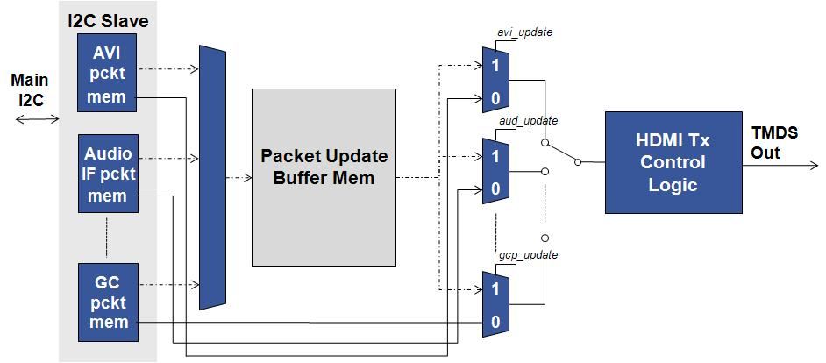
Packet Update Feature (2) Block Diagram

Slide 39
HDCP
HDCP is always initiated with the following sequence
Enable HDCP by setting 0xAF[7] to 1
Wait for BKSV Ready Interrupt (0x97[6]) to be 1
Collect BKSV from register map and check with revocation list
Clear BKSV Ready Interrupt by writing 0x97[6] = 1
If the Tx is connected to a single device, then HDCP authentication is complete
Check that 0xAF[7] is still set to 1 at least once every 2 seconds until HDCP is disabled to avoid external register tampering
If the Tx is connected to a repeater device, then the additional steps on the following page should be followed

Slide 40
HDCP Repeater Case
After clearing the BKSV flag, if the interrupt occurs again…
Additional BKSVs will be stored at I2C address 0x7E
These are available 13 BKSVs at a time
After reading the BKSVs clear flag again by writing 0x97[6] = 1
If the interrupt occurs again…
Collect additional BKSVs from 0x7E
Continue this process until all BKSVs are read
One way to confirm that all BKSVs have been read is to check if the “HDCP Authenticated” interrupt 0x96[1] has occurred
Another way is to confirm this is to check that the BKSV ready interrupt 0x97[6] remains 0 after clearing it
The ADV7513 supports up to128 BKSVs, which is the maximum number allowed by HDCP 1.3

